Slide 1
Ocean Liner Tycoon
Lycia Stenson

Slide 2
What is Ocean Liner Tycoon?

Slide 3
What is Ocean Liner Tycoon?
‘Ocean Liner Tycoon’ is a mobile tycoon game.
Tycoons are a very popular genre in the mobile market.
Players build a fleet of ocean liners, with the ability to customise the design and structure of each ship.
Players also manage their fleet, taking passengers on voyages.
Features a low poly art style which suits mobile, and ensures a wide range of devices will be capable of running the game.
Notes:
Statista, Simulation Games. Available at: https://www.statista.com/outlook/amo/app/games/simulation-games/worldwide (Accessed 18th December 2024)

Slide 4
The Gameplay Loop
Design Ship
Voyages
Profit
Upgrades
Players design a ship for their ocean liner fleet, customising the shape of the hull and superstructure, and designing interior spaces.
Ships automatically make voyages viewable on a world map. Up close the player can micromanage and control a specific ship.
The player profits in-game currency from voyages, the amount depending on how much the passengers enjoyed their time and the facilities.
The in-game currency can be spent to upgrade ship technology and entertainment, and to design and build new ships.

Slide 5
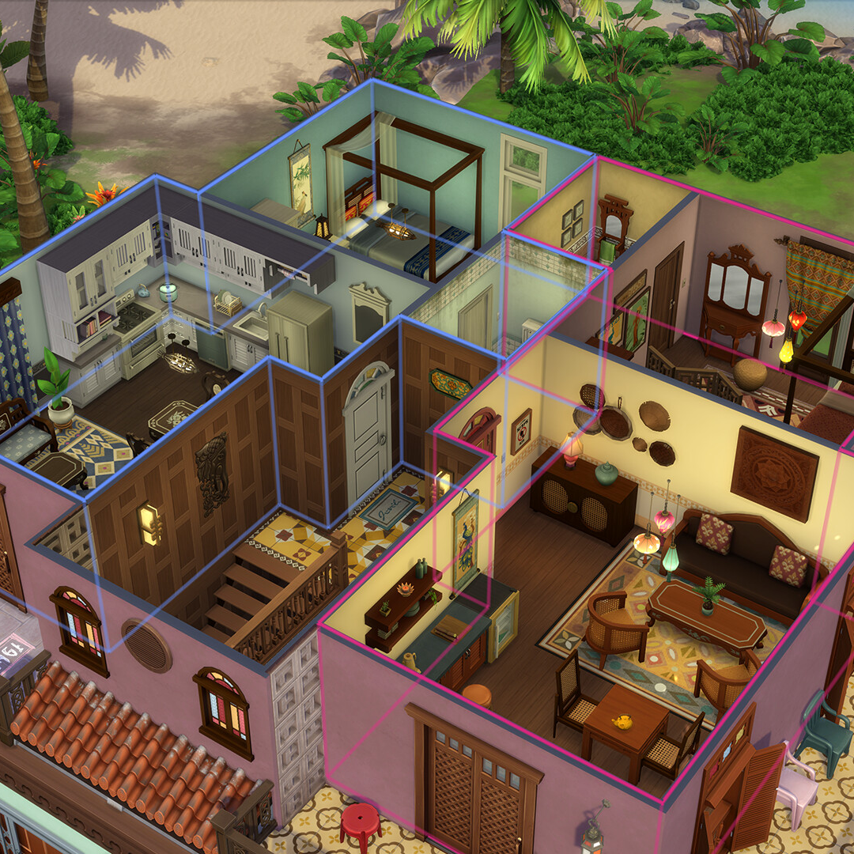
Cutaway View
During both the ship building and micromanage stages of the game, when the player zooms in the perspective closer, the selected deck will be displayed with a cutaway effect like that of The Sims.
Notes:
Electronic Arts, The Sims™ For Rent Expansion Pack. Available at: https://www.ea.com/en-gb/games/the-sims/news/for-rent-expansion-pack (Accessed 16th December 2024)

Slide 6

Target Audience
Maritime Enthusiasts
Wider Audience
The primary target audience is enthusiasts of maritime history.
The game will also appeal to a wider audience due to the continuing presence of the Titanic in popular culture.
Notes:
Paramount Pictures and 20th Century Fox, Titanic (1997) 2012 Re-release poster. Available at: https://www.imdb.com/title/tt0120338/mediaviewer/rm901821184/ (Accessed 16th December)

Slide 7

‘The Natural Predator of the Ocean Liner’

Slide 8
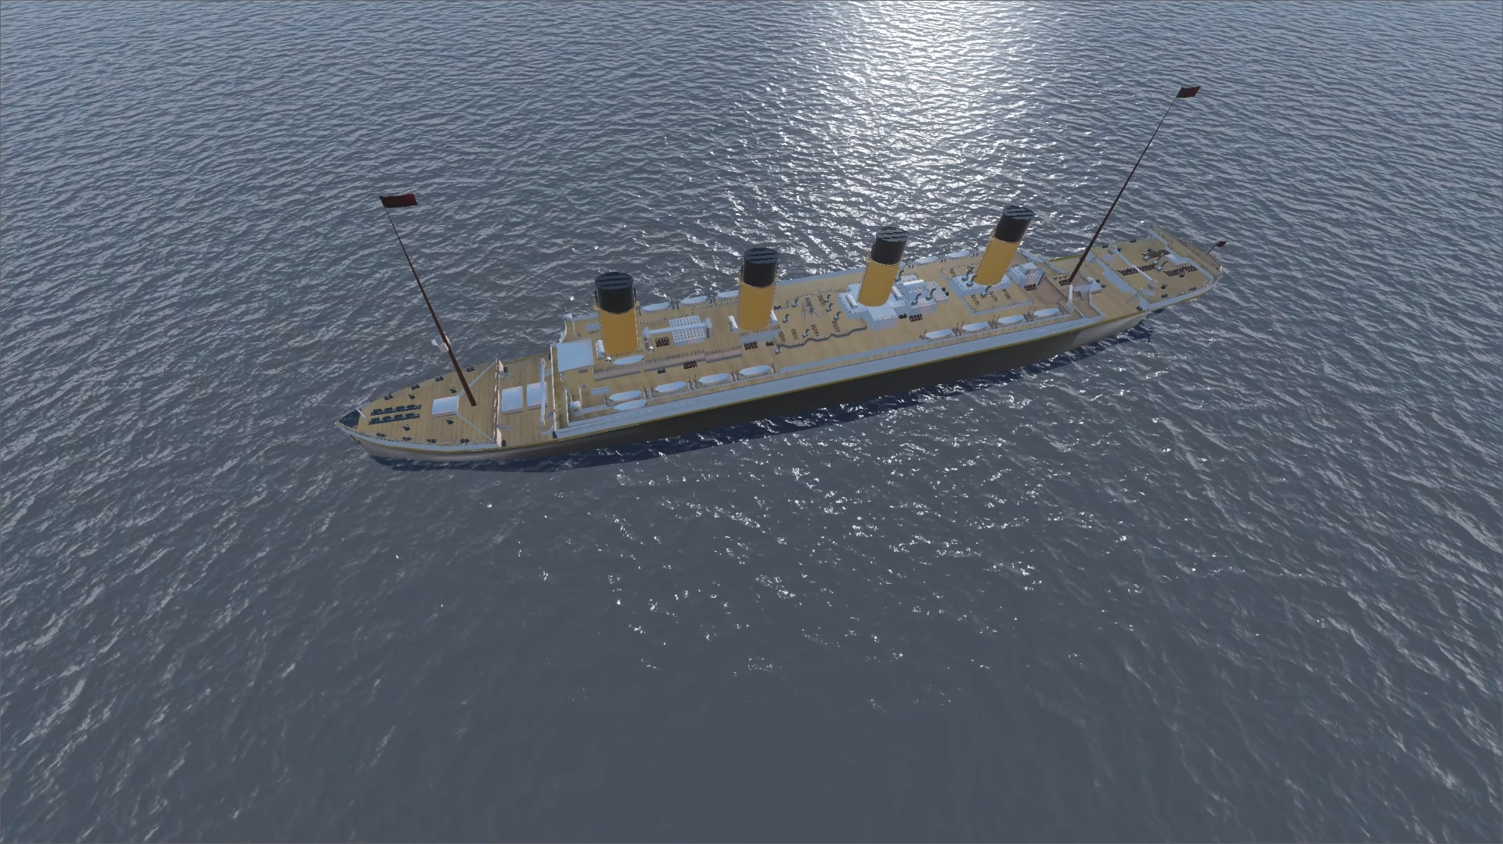
Graphics and Mechanics are not representative of final product. Early demonstration only.
Notes:
Millernathan471, RMS Olympic. Available at: https://sketchfab.com/3d-models/rms-olympic-6182116010494e4a954821ad39af73e0 (Accessed November 21st 2024)

Slide 9

Maximising Engagement
Ocean Liner Tycoon
Your ship ‘RMS Oceanic’ has struck an iceberg! Command the evacuation and rescue operation!
now
Ocean Liner Tycoon
Your ship ‘SS Adriatic’ has reached New York! Check out your profit!
30m ago
To maximise player engagement and retention, push notifications will inform the player of events in the game. For example, a ship arriving to their destination or encountering trouble during their journey.
Notes:
Stefan Schweihofer, Color Acrylic Paint Art. Available at: https://pixabay.com/photos/color-acrylic-paint-art-painting-4158152/ (Accessed 16th December 2024)

Slide 10
Marketing
Our marketing plan hinges on social media
We will utilise social media platforms’ built-in advertising services, such as on YouTube, TikTok, and Reddit.
Additionally, we will sponsor relevant content…
Notes:
Statista, Simulation Games. Available at: https://www.statista.com/outlook/amo/app/games/simulation-games/worldwide (Accessed 18th December 2024)

Slide 11


‘Our friend Mike Brady from Oceanliner Designs’
Mike Brady runs the popular YouTube channel Oceanliner Designs. Sponsoring his content will allow the game to reach a large audience of maritime enthusiasts.
Notes:
Michael C. Brady. Available at: https://www.grandvoyagegame.com/our-team (Accessed 15th December 2024)
Oceanliner Designs, Oceanliner Designs logo. Available at: https://www.youtube.com/@OceanlinerDesigns

Slide 12
Monetisation Plan
01
02
In-Game Currency
Ship Customisation
In-game currency will be purchaseable at different prices, e.g. £0.99, £1.99, etc
Exclusive options available only to premium users or for a smaller fee per item.
Premium Version
A premium version without ads will be purchaseable for ~£4.99
In this version, game progression will be easier as there will be no incentive to make additional puchases.
03
04
Ship Safety
Potential Expansion
Special items that ensure a ship’s successful voyage.
In the future, paid expansion packs could be released.

Slide 13
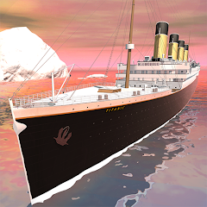

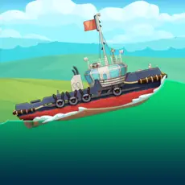
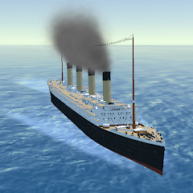
Competitors What’s different about ‘Ocean Liner Tycoon’?
Idle Titanic Tycoon: Ship Game
Stormworks: Build and Rescue
The player captains the Titanic. As a tycoon game it shares some similarities with our game but lacks ship building and fleet management mechanics.
Players build and pilot vehicles including ships. The game does not contain a liner tycoon aspect, having a disaster relief career mode instead.
Ship Simulator: Boat Game
Ocean Liner Simulator
The player builds a nuclear power plant, transporting equipment and resources via different unlockable boats. This gives the game a sense of progression similar to ‘Ocean Liner Tycoon’ which the other games lack.
The player controls four famous ocean liners navigating in and out of ports. The game lacks ship building and tycoon business aspects.
Notes:
IsCool Entertainment, Idle Titanic Tycoon; Ship Game. Available at: https://play.google.com/store/apps/details?id=com.neonplay.casualidletitanictycoon (Accessed 16th December 2024)
Azur Interactive Games Limited, Ship Simulator: Boat Game. Available at: https://apps.apple.com/gb/app/ship-simulator-boat-game/id6451137140 (Accessed 16th December 2024)
Geometa, Stormworks: Build and Rescue. Available at: https://geometa.co.uk/stormworks (Accessed 16th December 2024)
Aleksander Turkin, Ocean Liner Simulator. Available at: https://play.google.com/store/apps/details?id=com.TAV.OceanLiner (Accessed 16th December 2024)

Slide 14

The Team
Lycia Stenson
Todd Clark
Kelly Krause
Project Lead
Lead Programmer
Lead Designer
Lead Artist
Lisa Curtis
Melissa Curtis
Technical Designer
Programmer
Prop & Set Artist
Notes:
SVG Repo, Pen Nib SVG Vector. Available at: https://www.svgrepo.com/svg/532991/pen-nib (Accessed 18th December 2024)

Slide 15
Development Timeline
Start development
Closed Beta
Release
The team will get to work building the first prototype of the game.
Running a closed beta with members of the community built over development.
Releasing on Google Play and iOS App Store
Feb
2025
May
2025
Aug
2025
Oct
2025
Jan
2026
Working prototype
Marketing
Demonstrating core gameplay mechanics such as ship building and voyages.
Begin sharing progress on social media.
Ramp up marketing of the game. Advertising on social media with platform services and sponsored content.

Slide 16
Cost Overview
Personnel
Hardware
Office
Marketing
Programmers, designers, and artists building the game.
Development PCs and smartphones for testing.
Graphics tablets for artists.
Office space will enable better communication and work between team members.
Social media advertising, such as YouTube, TikTok, Reddit, and Sponsorships
Notes:
References can be found in notes section of Cost Breakdown

Slide 17



Software Costs?
Free and Open Source painting program
Godot
Blender
Godot is a Free and Open Source game engine, meaning zero royalties.
Like Godot, Blender is a Free and Open Source 3D modelling software, meaning zero royalties.
Notes:
Godot Foundation, Vertical Logo Colored Light. Available at: https://godotengine.org/press/ (Accessed 17th December 2024)
Blender Foundation, Blender Logo Square Icon. Available at: https://www.blender.org/about/logo/ (Accessed 17th December 2024)
Krita Foundation, Krita Logo Light. Available at: https://krita.org/images/ (Accessed 18th December)

Slide 18
Why We Need a Publisher
Why you should publish ‘Ocean Liner Tycoon’
We require funding to develop the game
Funding
Recouping investment
While recouping investment, 60/40 revenue split.
As a publisher you can provide guidance on marketing.
Marketing
Future revenue
40/60 split after recouping investment.
Quality assurance is an important stage of development.
QA
Untapped Market
Lack of ship building mechanics in mobile market
Support publishing on Google Play and iOS App Store
Platform
Unique Selling Point
Ship building combined with tycoon

Slide 19
Any Questions?
Ocean Liner Tycoon
lycia@oceanlinertycoon.com
oceanlinertycoon.com
Relevant Harvard references can be found in the notes section of each slide.
Notes:
Slidesgo, Reconstruction Era and the Gilded Age - History - 11th Grade. Available at: https://slidesgo.com/theme/reconstruction-era-and-the-gilded-age-history-11th-grade (Accessed December 12th 2024)
Slidesgo, Reconstruction Era and the Gilded Age - History - 11th Grade Infographics. Available at: https://slidesgo.com/theme/reconstruction-era-and-the-gilded-age-history-11th-grade-infographics (Accessed December 17th 2024)

Slide 20
Cost Breakdown
Expense | Count | Single | Yearly | Monthly | Total
Personnel | 5 | - | £26,004.00 | £2167.00 | £130,020
Dell XPS | 5 | £1,499.00 | - | - | £7,495.00
Samsung A15 | 5 | £129.00 | - | - | £645.00
Graphics Tablet | 2 | £69.99 | - | - | £139.98
Office space | 1 | - | £29,160 | £2,430 | £29,160
Social Media Advertising YouTube, TikTok, Reddit, etc. | 6 Months | - | - | £1,525 | £9,150
Creator Sponsorship | 3 | £30 CPM * ~170k views = ~£5,100 | - | - | ~£15,300
Total |  |  |  |  | £191,909.98
Notes:
Dell Technologies, XPS Desktop. Available at: https://www.dell.com/en-uk/shop/desktop-computers/xps-desktop/spd/xps-8960-desktop/bdx89632nkm (Accessed 18th December 2024)
Samsung Electronics, Samsung Galaxy A15. Available at: https://www.samsung.com/uk/smartphones/galaxy-a/galaxy-a15-blue-black-128gb-sm-a155fzkdeub/ (Accessed 18th December 2024)
Wacom, Wacom Intuos. Available at: https://www.currys.co.uk/products/wacom-intuos-ctl4100kn-5-graphics-tablet-10178473.html (Accessed 18th December 2024)
Office Freedom, Southgate House Southgate Street, Gloucester. Available at: https://www.rightmove.co.uk/properties/155494793 (Accessed 18th December 2024)
Spending £50 a month on social media advertising budget over six months leading up to and over launch.
Stephanie Heitman, Starter Guide to YouTube Advertising Costs in 2024 (+5 Ways to Spend Less). Available at: https://localiq.com/blog/youtube-advertising-cost (Accessed 18th December 2024)
Creator sponsorship ~170k views averaged from 12 most recent videos by Oceanliner Designs
Oceanliner Designs, Oceanliner Designs YouTube channel. Available at: https://www.youtube.com/@OceanlinerDesigns/videos (Accessed 18th December 2024)

